Slide 1



Introduction to
direct nuclear reactions
And codes
Young-Ho Song(IRIS, IBS)
핵물리 여름학교, 2024.07.01. 제주

Slide 2

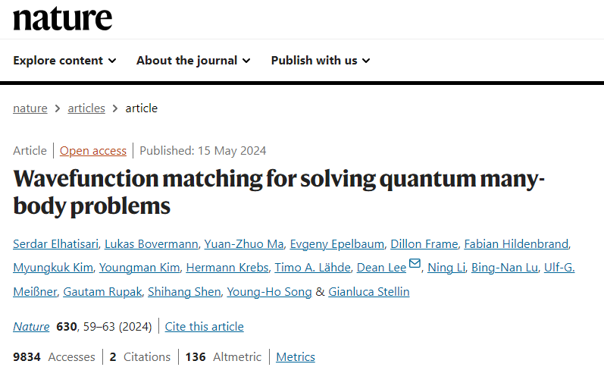
Nuclear Lattice Effective Field Theory
Recently published an article in Nature (2024)
: 3 Korean researchers

Slide 3
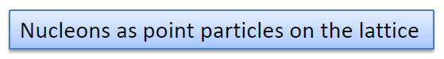
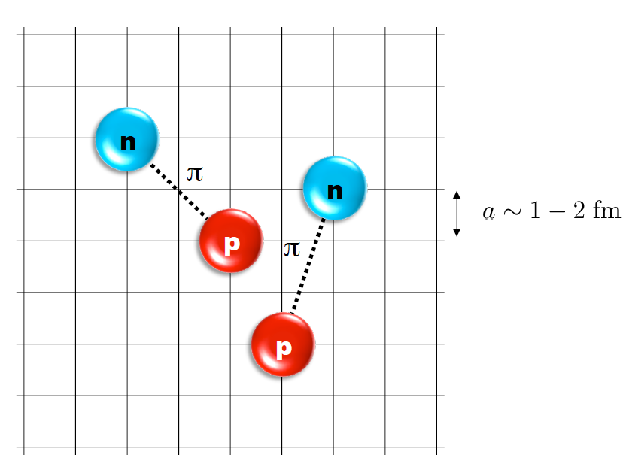
Nuclear Lattice Effective Field Theory
Quantum many-body problem is extremely difficult to solve
(Especially for heavy system.)
There are many different approaches.
One of them is the nuclear lattice effective field theory
Basically Computes
Quantum many-body wave functions
On the lattice
From nucleon-nucleon interactions
Need super computers.

Slide 4
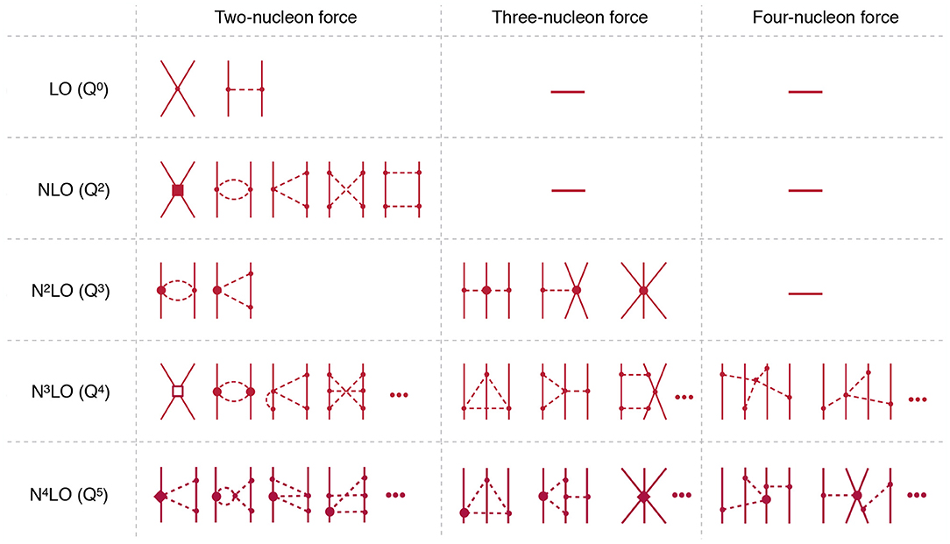
Chiral Effective Field Theory
카이랄 유효 이론 : QCD 의 유효이론. Model independent.
Explains why 2-body force is the most important.
3-body force is naturally introduced.

Slide 5
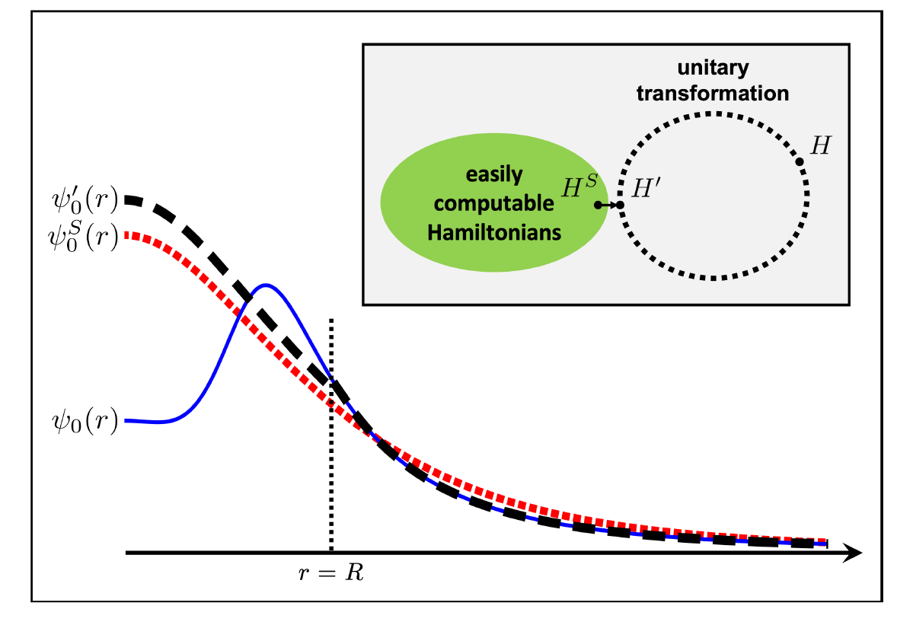
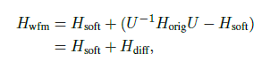
Wave Function matching
H and H’ are fully equivalent to two-body observables
The goal is to make the perturbation expansion from “simple” wave function gives a good convergence

Slide 6
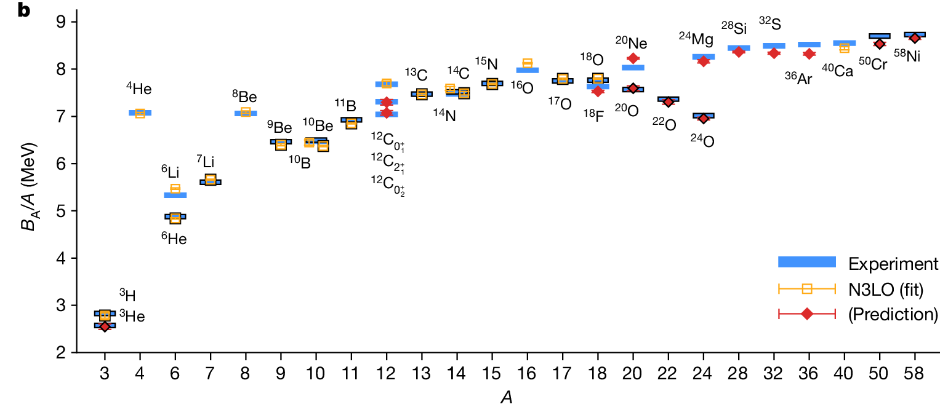
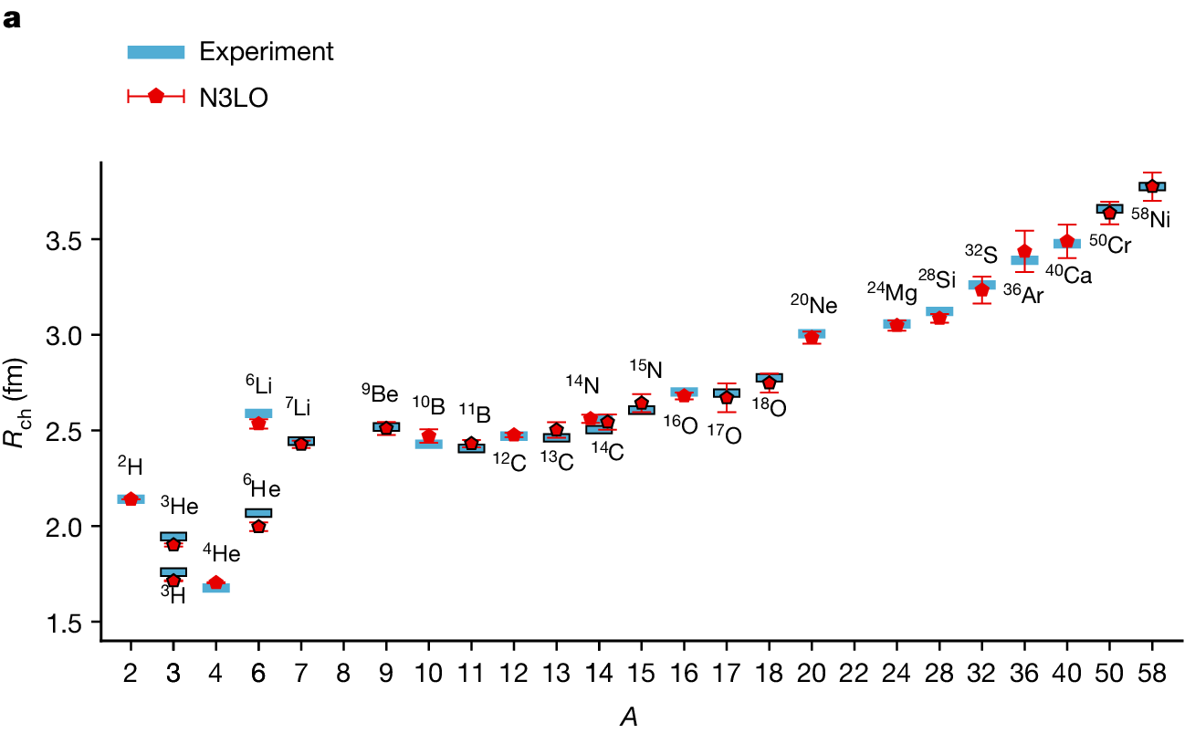
Nuclear Lattice Effective Field Theory
ab initio
Prediction
On binding energy
And charge radius
Up to A ~ 58
The recent progress
Of ab-initio approaches
Are very promising.

Slide 7

Part 1.
Introduction

Slide 8

Why Nuclear Reaction theory?
1. Introduction
Many elements in nature are created by nuclear reactions in star.
→ nuclear reaction cross sections are important.
Much information on nuclear physics comes from nuclear reaction experiments
→ Tool to extract meaningful information of nuclear structure, nuclear force
Fully microscopic many-body calculation of nuclear reaction is not feasible in general.
→ Needs reaction models for specific types of reactions

Slide 9
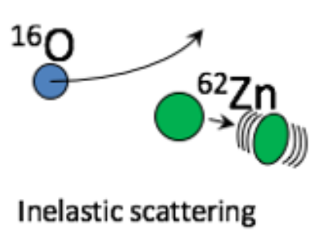
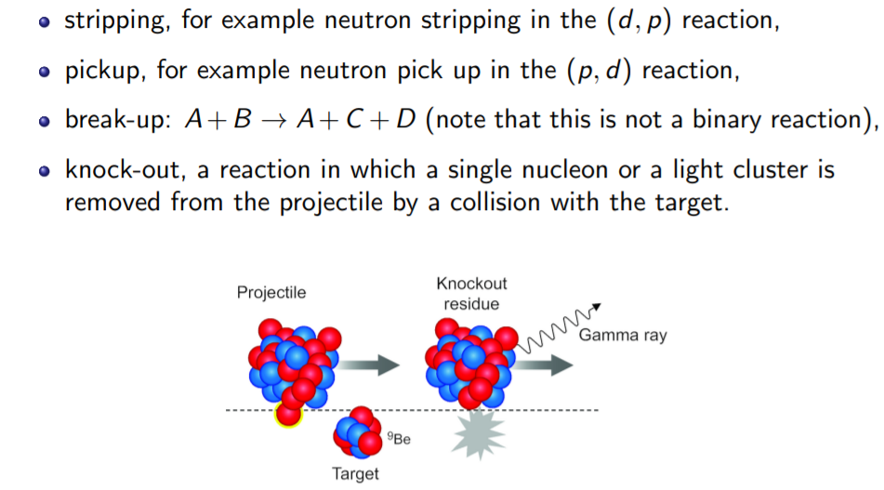
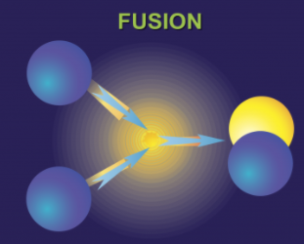
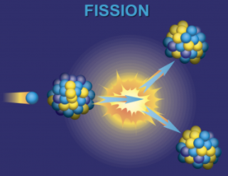
Types of Nuclear Reaction
1. Introduction
Types of reactions (according to reaction products: input and output)
Elastic : (No change in projectile and target)
Non-elastic
Inelastic : (Projectile or target changes internal structure)
Rearrangement(transfer) : (Projectile and target changes)
Fusion, capture
Fission
Etc. (many different names for specific reactions)

Slide 10
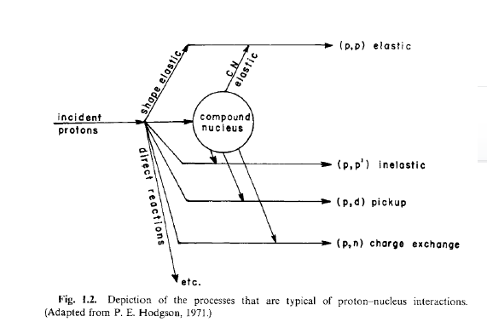
Types of Nuclear Reaction
1. Introduction
Types of reactions
(reaction nature, time,
energy transfer)
Direct
Compound
For the same projectile and target product,
Both direct and compound reaction may contribute.

Slide 11
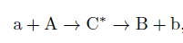
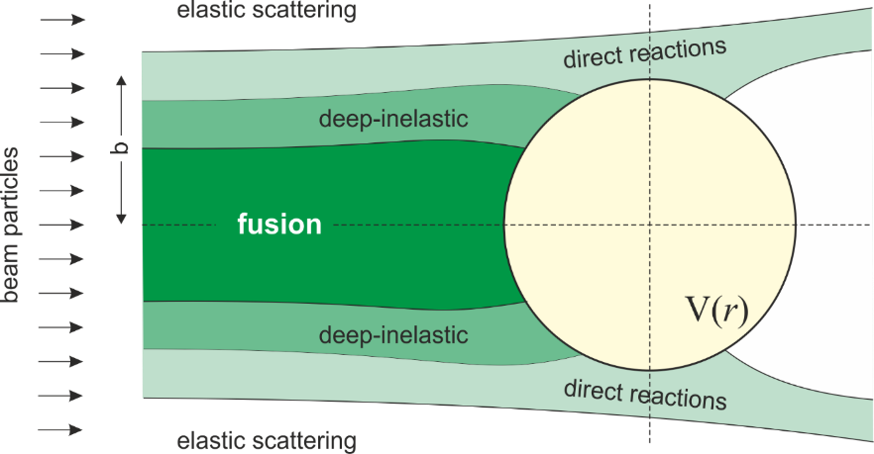
Types of Nuclear Reaction
1. Introduction
Direct Reaction : glancing contact, immediate separation,
near the nuclear surface, large impact parameter,
short time scale ,fast (~10^-21 s)
strongly forward peaked
interact with only few nucleons or nucleus as a collective whole
→ effective Few Body Problem
Compound Reaction : slow, massive energy sharing,
involve all projectile + target
fusion, decay. Isotropic
thermal equilibrium,
independence hypothesis(loss of memory).

Slide 12
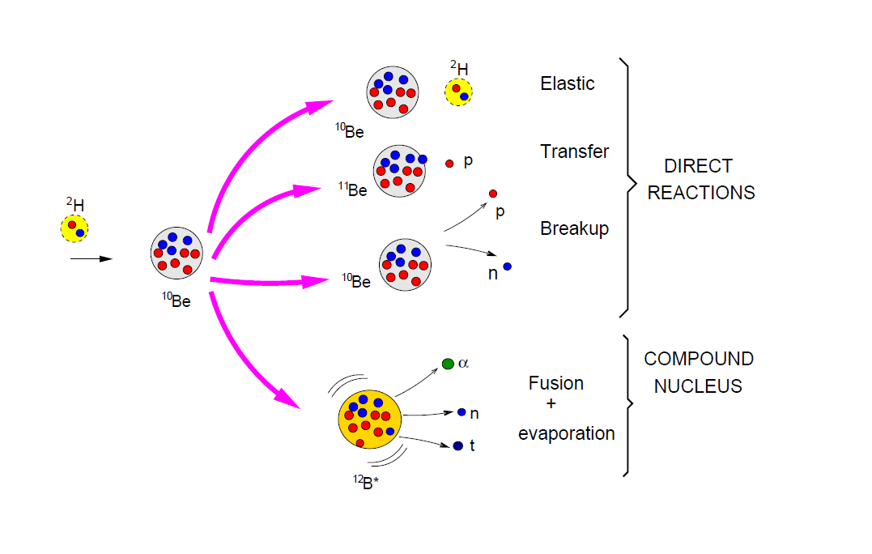
Types of Nuclear Reaction
1. Introduction

Slide 13
What can we learn from the direct reaction?
1. Introduction
Here we only consider direct reactions.
Direct reaction is an important tool
to study nuclear interaction, structure and astrophysics.
What can we learn from the direct reaction?
For example (Not complete list):
elastic scattering: average strength of nuclear interaction, size of nuclei
Inelastic scattering: spectroscopic information (Energy, angular momentum, parity)
Rearrangement reaction: spectroscopic information
one-nucleon transfer: single particle level
two-nucleon transfer : correlation of two nucleons

Slide 14
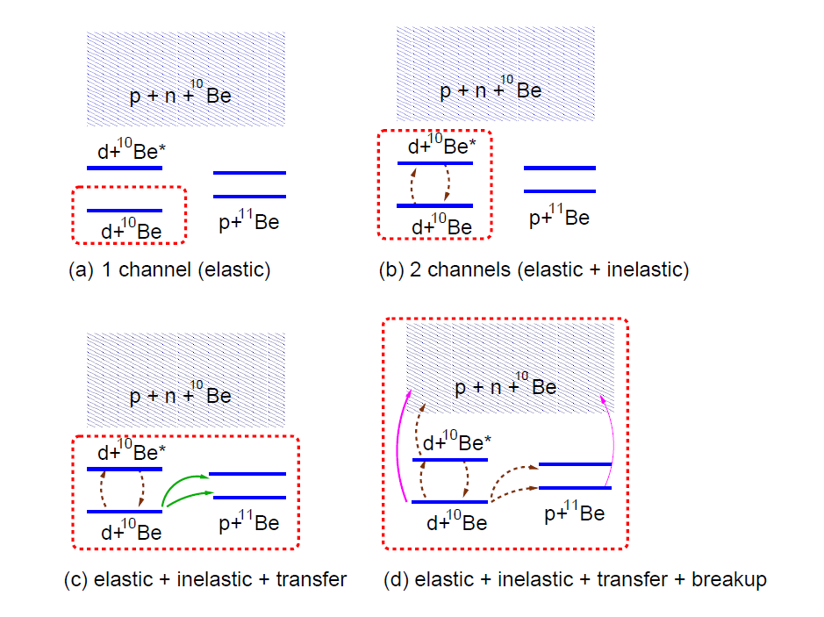
Nuclear Reaction Model
1. Introduction
In principle, nuclear reaction is a many-body problem and
It is very difficult to solve exactly (even when interactions are known).
Thus, usually the problem is approximated as an easier few-body problem.
Ignore internal degrees of freedom
or use a simple model of nuclear structure(collective model)

Slide 15
Nuclear Reaction Model
1. Introduction
There are many direct nuclear reaction codes available.
* FRESCO, ECIS, TWOFNR, DWUCK…..
In this lecture, we focus on Elastic, Inelastic, transfer … reactions in simple structure/reaction models.
And explain how to calculate the reaction cross section in practice with simple examples.
For a simple model, one can use a GUI code for a quick calculation.
Unfortunately, for more complicate model(like coupled reaction channel model),
one have to use original codes with appropriate assumptions.

Slide 16
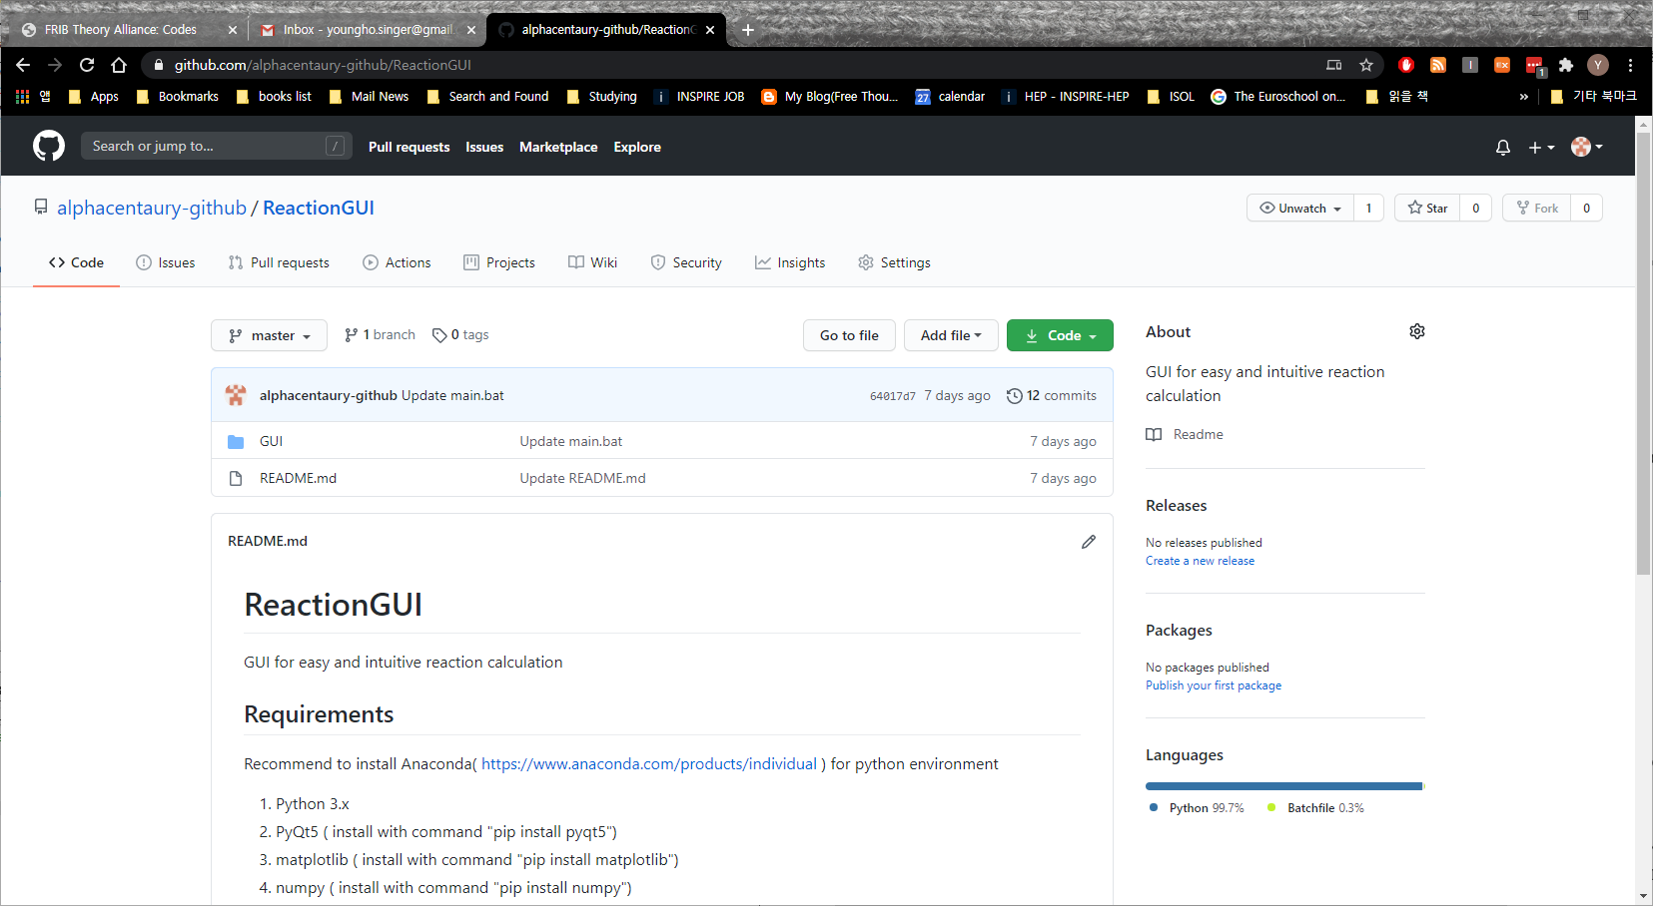
ReactionGUI code
3. Reactions
https://github.com/alphacentaury-github/ReactionGUI
Written by Y.-H.Song (IRIS) and I.J.Shin (IRIS).
Combine GUI + FRESCO + other reaction codes
Require python 3.x and several packages.

Slide 17
Part 2.
Basics of nuclear reaction theory

Slide 18
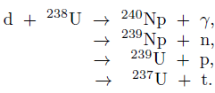
Conservation in Nuclear Reaction
2. Basic
B(A, C)D
target
projectile
Projectile
like
Target
like
Conservation laws in nuclear reaction
Baryon Number
Charge
Energy and linear momentum
Total angular momentum
Parity
(approximate) Isospin
initial S-wave capture → L=2,3,4 final states , parity imply L=3

Slide 19
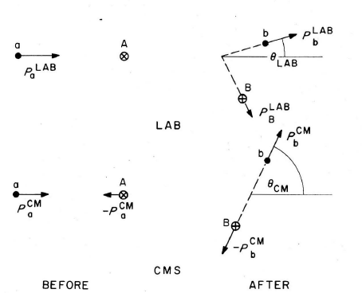
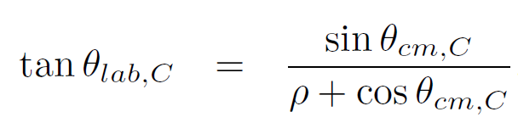
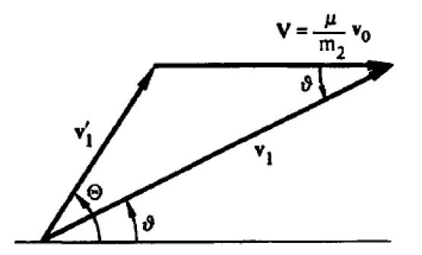
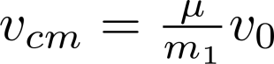
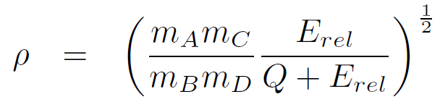
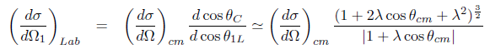
Kinematics
2. Basic
Typically, two body reactions.
Theoretical calculations are done in
Center of mass frame.
In most case, codes assume regular kinematics ( projectile is lighter particle)
Differential cross sections are shown in terms of projectile-like particle
Need convert CM<->LAB
(Satchler fig2.1)
vcm
vlab

Slide 20
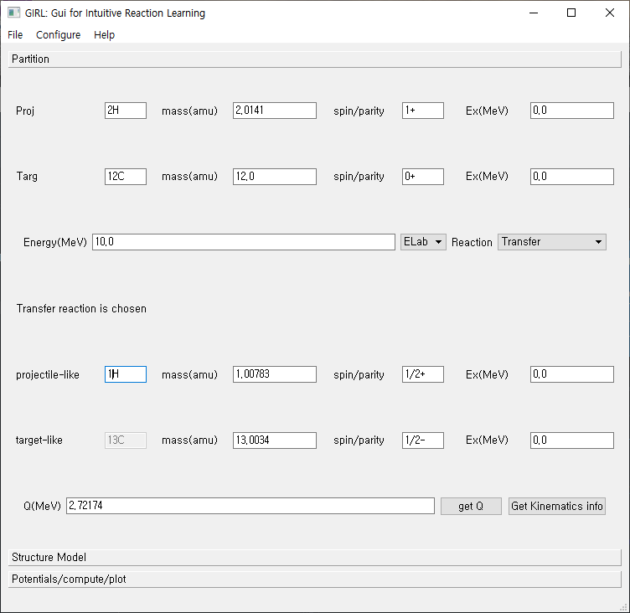
ReactionGUI code
2. Basic
File:
Save/Load
Input parameter values
Three tabs
Partition
Structure Model
Potentials/compute/plot

Slide 21
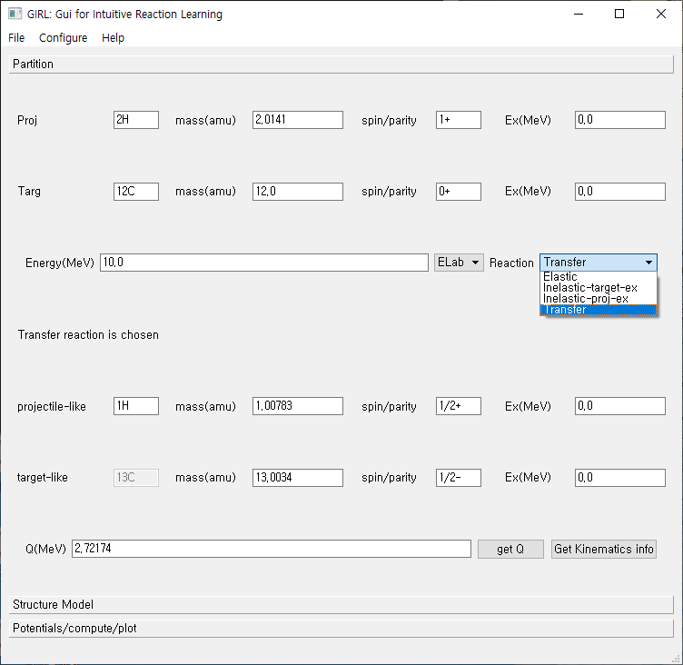
ReactionGUI code
2. Basic
Neutron : 1n
Proton : 1H
Deuteron : 2H
projectile
target
Incident Energy/
Type of reaction
kinematics

Slide 22
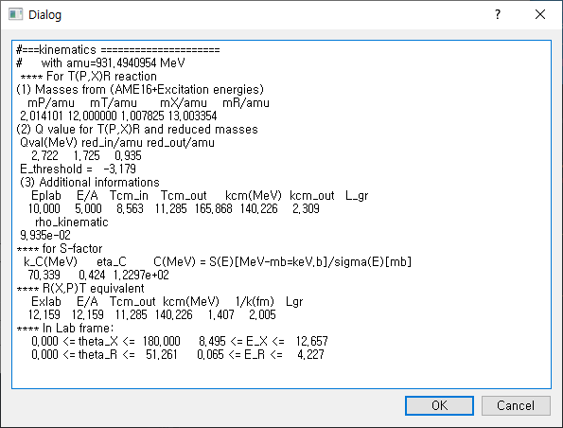
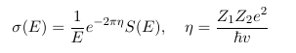
ReactionGUI code
2. Basic
Get kinematics
button

Slide 23
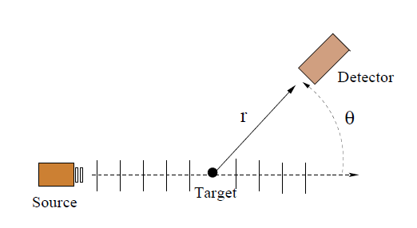
Cross Section
2. Basic
Reaction Theory and Experiments can be compared with Cross Section
Measurement
(Number of particles detected in solid angle/sec)
= (Number of incident particles/sec)*(effective area)/(incident area)
= (Number of incident particles/sec)
*(effective area per target)*(number of target particle in area)/(incident area)
= (Number of incident particles/sec)
*(effective area per target)*(target particle number density)*(target thickness)
(Cross section) = (effective area per reaction)
does not depends on the experimental condition ( target thickness, beam size…)

Slide 24
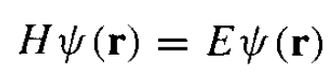
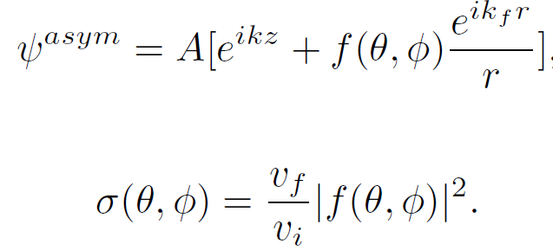
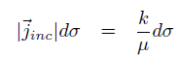
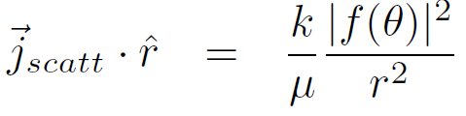
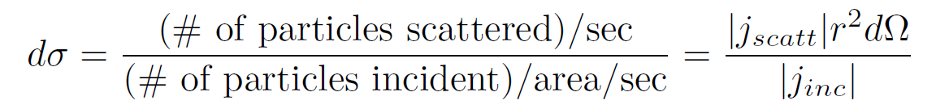
Cross Section
2. Basic
In theory, cross section can be obtained from the asymptotic wave function(scattering amplitude)
Theory
what is the interaction (Hamiltonian)
How to get the wave function
Reaction model

Slide 25
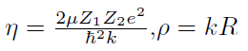
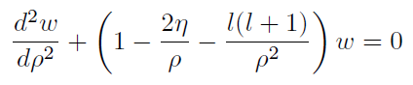
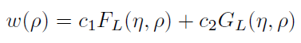
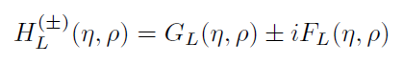
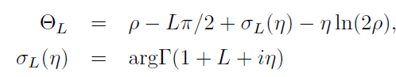
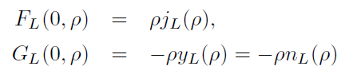
Short review Scattering theory
2. Basic
Coulomb Scattering
Sommerfeld parameter
Free particle wave function
Spherical Bessel (Neumann) function
with eta=0, V=0
Coulomb phase shift

Slide 26
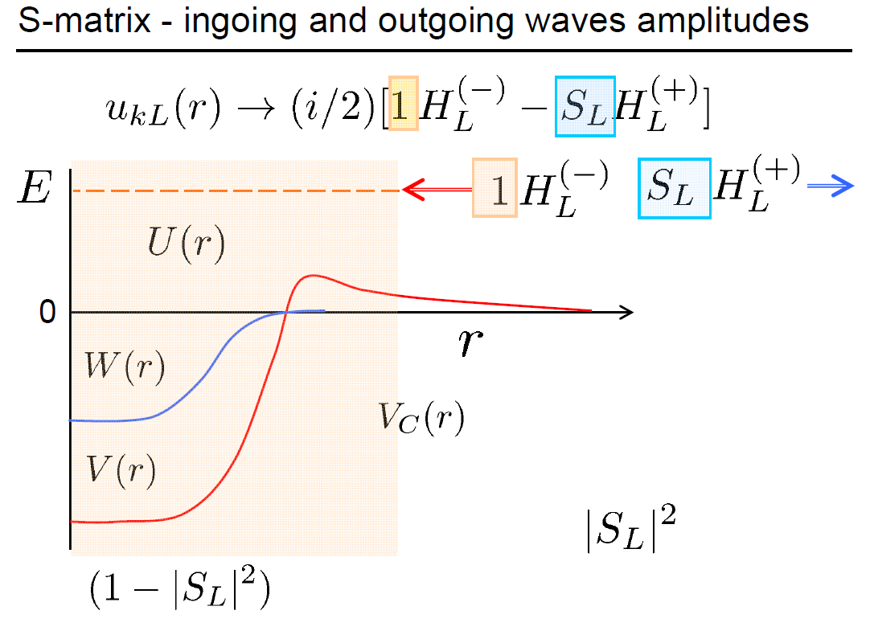
Short review Scattering theory
2. Basic
One can interpret
S-matrix as a
Reflection coefficient.
Probability of Reflection
Probability of absorption/transmission
(Figure from J.Tostevin’s slide)

Slide 27
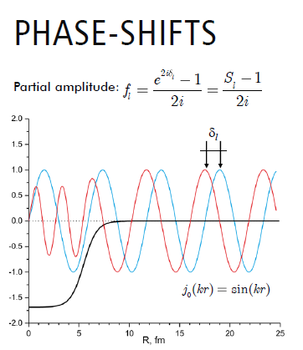
Short review Scattering theory
2. Basic
If there is no other channels,
Flux will be conserved and
S will be unitary , |S|=1.
Define phase shift
Phase shift is real number.
If there is other channels,
flux can be lost, |S|< 1.
phase shift can be complex number.
If one consider other channels,
S becomes a matrix, S(a→ b)

Slide 28
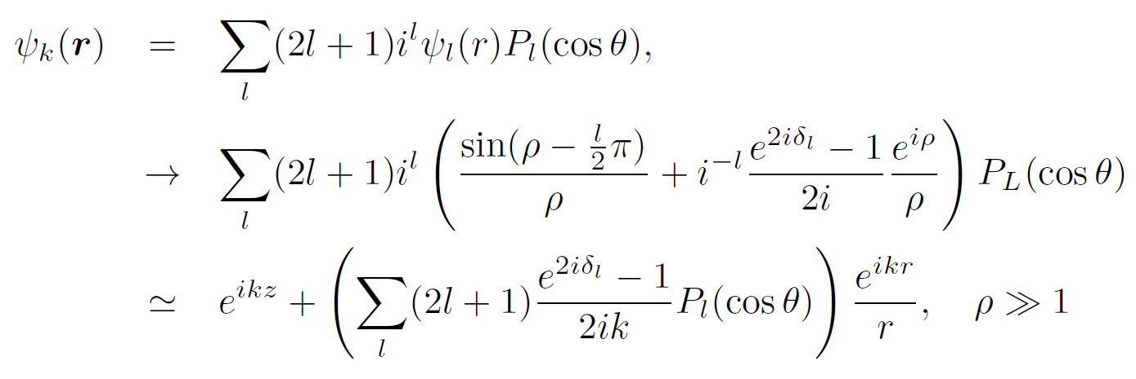
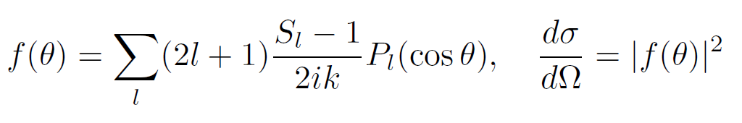
Short review Scattering theory
1. Introduction
Partial wave expansion→ phase shift, S-matrix, T-matrix

Slide 29
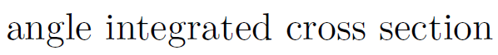
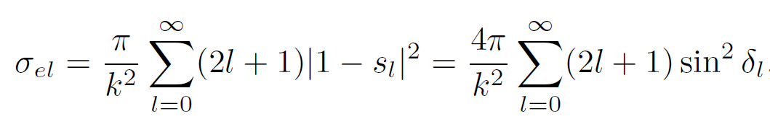
Short review Scattering theory
1. Introduction
(total cross section) = (elastic cross section) + (reaction cross section)
(reaction cross section) describe the disappearance of flux from elastic channel
~ (absorption )

Slide 30
Part 3.
Elastic scattering

Slide 31
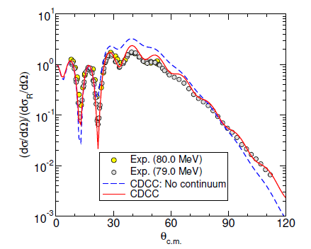
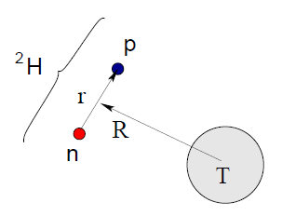
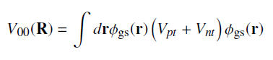
Elastic scattering
3. Elastic
Elastic scattering are usually described in optical model.
No internal structure of nuclei → point particles
Complex optical potential → implicitly include structure of nuclei
Only elastic channels are explicit
In some case, one can study the structure of nuclei with elastic scattering
With additional model.
Include additional channel effects on elastic scattering→ coupled channels
A model of internal structure of nuclei
Example: Elastic scattering of Halo nuclei ( CDCC calculation)
(From A. Moro’s lecture)

Slide 32



Semi-classical interpretation
3. Elastic
Fresnel
Fraunh”offer
Nuclear interaction
~ strong, attractive, short ranged.
Coulomb barrier
(Fig. from A.M. Moro’s lecture)

Slide 33


Coulomb barrier
3. Elastic
Rough Estimation Coulomb Barrier

Slide 34

Elastic scattering
3. Elastic
Typical energy dependence
Common to use ratio to Rutherford cross section
(Fig. from A.M. Moro’s lecture)

Slide 35


Semi-classical interpretation
3. Elastic
One can find (interaction) radius of nuclei
From elastic scattering.

Slide 36

Semi-classical interpretation
3. Elastic

Slide 37
Model space
2. Basic
But, nuclei is not point particle!→Choice of model space → different reaction model

Slide 38





Optical potential
2. Basic
Feshbach Effective Hamiltonian
Acts only on P(model space)
Complex
Negative imaginary potential
→ loss of a probability flux
from model space
4. non-local
Theoretically we may compute effective Hamiltonian.
In practice, effective potential are fitted to experiments.
Optical potential in elastic channel simulates the neglected model space contributions

Slide 39


Optical Model
3. Elastic
Optical Model
Ignore internal structure of target and projectile
Usually Optical potential are fitted to reproduce elastic scattering experiments.
Only inputs are
mass/spin of projectile/target
Projectile Energy
Optical potential

Slide 40

Optical Potential
1. Basic
Optical potential is complex in general
→ Disappearance of flux from the elastic channel
Negative imaginary potential implies reduction in flux in elastic channel
→ Absorption cross section
(total cross section) = (elastic cross section) + (reaction cross section)
(reaction cross section) describe the disappearance of flux from elastic channel
~ (absorption )
In coupled reaction calculation,
(reaction cross section) = (sum of included reaction cross section)
+(absorption from all other reactions/absorption/fusion)

Slide 41



Optical potential
3. Elastic
It is common to use (phenomenological) optical potential to solve
Elastic scattering or get distorted waves.
Typically, Woods-Saxon form : Depth, (reduced) Radius, diffuseness
Central = Volume + Surface (derivative)
Spin-orbit interaction : projectile spin, orbital angular momentum
(spin-spin),(tensor) interactions are not considered in most case.

Slide 42


Optical potential
3. Elastic
Be careful for the definition of parameters in literature
not unique.
Reduced radius : for light projectile, A_p=0 are used.
Spin orbit strength definition can vary.

Slide 43
Optical potential
3. Elastic
Typical values : V~ 40-50 MeV, W~ 10-20 MeV, Vso~ 5-8 MeV
r ~ 1.2 fm, a~ 0.6 fm
Parameters depends on projectile, target and energy
Sometimes global optical potential available
Global Optical Potentials: RIPL-3 https://www-nds.iaea.org/RIPL-3/
Phenomenological optical potential model allows to estimate
the reaction cross section
folding potential
nuclear density + effective NN interaction(M3Y , JLM etc. )
single folding or double folding

Slide 44



ReactionGUI code
3. Elastic

Slide 45

ReactionGUI code
3. Elastic
Various potential shapes
For example:
P+112Cd at 20.4 MeV

Slide 46

Double Folding potential
3. Elastic
Typically, optical potentials are fitted to experimental data.
If experimental data is not available?
Either use global optical potential or folding potential.
NN interaction should be an effective interaction.
M3Y or density-dependent M3Y interaction are commonly used.

Slide 47

Double Folding potential
3. Elastic
Get Folding V
Get density profile from HFB-14 results If available.
(From RIPL-3)
Or User input of density profile
* Because of double folding, it requires density even for proton.

Slide 48

Double Folding potential
3. Elastic
For example,
P+112Cd at 20.4 MeV
Double Folding M3Y with
HFB-14 density of 112Cd
→ only real part of V
(2) + surface imaginary potential

Slide 49



Fitting OMP
3. Elastic
Exp
data
Fit
Elastic
OMP

Slide 50

Fitting OMP
3. Elastic
Result of fitting
At the moment, no automatic update of parameter after fitting available

Slide 51

Example
3. Elastic
Halo nuclei case:
→Elastic scattering is affected from break up channels.
(Optical potential from usual nuclei is not appropriate.)
→strongly coupled to breakup channels
(Usual optical potential+ coupling effects from breakup channel.)

Slide 52
Part 4.
Inelastic scattering

Slide 53

Inelastic scattering
4. Inelastic
Nuclei are not point particles : internal structure can change (excited)
Inelastic scattering : A+B → A’+B* (no rearrangement of particles )
From the energy and momentum, angular momentum conservation,
If one measure the energy and angle distribution of projectile,
One can get energy and angular momentum of excited states.
Transferred energy→ Q-value
transferred orbital angular momentum ΔL

Slide 54


Inelastic scattering
4. Inelastic
Necessary information/inputs
Projectile nuclei
Target Nuclei
Excitation energy
transferred angular momentum
Optical potential
Coupling potential
Coupling potential describes how the internal structure can change
Structure Information
Reaction Model

Slide 55

DWBA
2. Basic
For weak coupling → DWBA approximation
Consider two channels
If coupling between different channels are weak,
We may ignore them or treat as a perturbation.
To get transition from 0→ 1 channel,
We may ignore V_{01} and treat V_{10} as a perturbation for the other channel.
(1) First solve elastic channel with distorting potential V_{00}
(2) Solve transition with distorting potential V_{11} and transition coupling V_{10}

Slide 56




DWBA
2. Basic
Born Approximation
Distorted Wave Born Approximation
Distorted waves
Now remaining problem is
(0) What is the optical potential(entrance , exit)?
What is the coupling potential for specific reaction?
What is the bound state wave function?

Slide 57


Coupled Channel calculation
2. Basic
If the coupling between channels is weak
→ DWBA
If several channels are strongly coupled →
Coupled channel calculation

Slide 58


Inelastic scattering
4. Inelastic
Most common simple reaction model for inelastic scattering
Collective Model
Cluster Model
Collective Model : Excitation interpreted macroscopically
Rotations or surface vibrations
Cluster Model : Excitation interpreted as change of
a nucleon or cluster wave function

Slide 59




Collective model
4. Inelastic
Excitation corresponds to changes of collective states|IM> → |I’ M’ >
What makes the inelastic transition?
Change of distance between projectile-target surface
Deformation of optical potential

Slide 60

Collective model
4. Inelastic
In collective model:
Coupling potential can be determined from deformation length operator
→ DWBA cross section ~ (deformation parameters)^2
→ one can determine deformation parameters from inelastic experiments.
In Rigid Rotor model
Deformation length
= β_{λ} R₀

Slide 61




Coulomb excitation
4. Inelastic
In general, both Coulomb and Nuclear couplings
Reduced Coulomb transition probability
In Rigid Rotor model,
Deformation parameter can be
Different for Coulomb and Nuclear

Slide 62

ReactionGUI for collective inelastic scattering
4. Inelastic
Inelastic scattering case
Spin/parity of excited state
Excitation energy
ReactionGUI use DWBA
Coupled Channel calculation can be done with FRESCO

Slide 63


ReactionGUI for collective inelastic scattering
4. Inelastic
For the moment,
Only Rotor Model
Is available.
(for collective excitation
model)
Deformation length
Is calculated
With r0=1.2

Slide 64

ReactionGUI for collective inelastic scattering
4. Inelastic
For example,
4He+20Ne , E=104 MeV
4He+20Ne*(2+,1.63 MeV)

Slide 65



Inelastic scattering (cluster model)
4. Inelastic
v
One can also describe
Inelastic scattering as a single particle excitation
→ Model the system as 3-clusters system
r
c
R
Excitation = s.p.(cluster) excitation
T
Potentials
Optical potential
→ describe scattering
Binding potential
→ describe ground state
and excited state
More details in transfer reaction

Slide 66
Part 5.
Transfer reaction

Slide 67


Transfer Reaction
5. Transfer

Slide 68


Transfer Reaction as a spectroscopic tool
5. Transfer
Transfer reaction cross section is sensitive
To the transferred angular momentum
(1) By analyzing angular distribution,
one can determine
the transferred orbital angular momentum
The quantum number of s.p. states
(2) In a s.p. picture,
one can extract S.F. from experiments
→ Spectroscopic information

Slide 69


Transfer Reaction
5. Transfer
Total Hamiltonian can be written
H = T(b) +T(x) +T(A) + V(b-x) +V(x-A) + V(b-A)
Prior form : T(b)+T(x)+V(b-x) as internal Hamiltonian
V(x-A) + V(b-A) makes transfer occur
Post form : T(x)+T(A)+V(x-A) as internal Hamiltonian
V(b-x)+V(b-A) makes transfer occur

Slide 70



Transfer Reaction
5. Transfer
Post form
DWBA
In many case, remnant correction are neglected.
For example, (d,p) reaction with heavy target

Slide 71



Transfer Reaction
5. Transfer
In DWBA
One needs to provide Overlap integral ( ~ bound state wave function)
Overlap integral requires many-body solution
→ Ignores core wave function
→ Simple approximation as two-body

Slide 72


Overlap function
5. Transfer
Instead of using bound w.f. as input,
Typically, one provide
Binding potential
N,L,J of bound state
Binding energy or separation energy
and adjust depth of binding potential
(well depth prescription)
Thus, instead of many-body wave function,
Use a single particle wave function.
Spectroscopic amplitude
Spectroscopic factors
To be exact, Anti-symmetry
of wave function have to be considered

Slide 73

Spectroscopic factor
5. Transfer

Slide 74

Overlap function
5. Transfer
(From Lecture of J.Tostevin)

Slide 75


Asymptotic Normalization Coefficient
5. Transfer
From the Separation energy and Coulomb interaction,
At long distance separation, we can expect the overlap function
Would be proportional to Whittaker function.
Coefficient is called ANC
It may be calculated from many-body theory.
Overlap function is sensitive to ANC at outside the range of nuclear potential.

Slide 76

Transfer Reaction in ReactionGUI
5. Transfer
Example:
48Ca(d,p)49Ca
E = 13 MeV
Entrance bound
d(1^+) = n+p
with BE=2.22 MeV
n=1 L=0
Exit bound
49Ca(3/2-)
= 48Ca(0+) + n(1/2+)
With BE=5.146 MeV
n= 2 L=1
Well-depth Prescription
Always check Parameters.

Slide 77


How many node for cluster?
5. Transfer
(7Li, alpha) reaction.
Node number?
(From Lecture of J.Tostevin)

Slide 78

How many node for cluster?
5. Transfer
(From Lecture of J.Tostevin)

Slide 79
Part 6.
Break up, CDCC, ADWA

Slide 80
Weakly bound nuclei
6. Breakup
Weakly bound nuclei :deuteron, Halo nuclei, nuclei near dripline
Large interaction cross section in nuclear collision at high energies
(→can be interpreted as a large radius, 6He, 11Li, 14Be )
Abnormal elastic cross section
(→ Disappearance of Fresnel peak near barrier energy)
Enhanced near-threshold breakup cross section in Coulomb dissociation experiments of neutron-halo nuclei. (CF of weakly bound nuclei suppressed above Coulomb barrier.→ breakup , incomplete fusion )
Narrow momentum distributions of residues when fast nucleon is removed. (narrow momentum distribution→ large spatial distribution)

Slide 81

Break up
6. Breakup
(From slides of A.M. Moro)

Slide 82


Continuum W.f.
6. Breakup
Unlike bound state wave function,
Continuum wave function does not
Vanish at large distance.
Non-normalizable
(Stable) Coupling is difficult to obtain
There are infinite number of energies
Continuum discretization
(1) Pseudo States method
(2) Bin method
(From slides of A.M. Moro)

Slide 83

CDCC
6. Breakup
CDCC describes
Elastic scattering
Breakup
At the same time
One have to specify how the bin is prepared.
FRESCO
Can compute
CDCC
Implementation of CDCC
In ReactionGUI is planned.
(From slides of A. Moro)

Slide 84


CDCC
6. Breakup
d + 58Ni
Elastic scattering
6Li = alpha + d
Importance of break up channels
For weakly bound nuclei.
(From slides of A. Moro)

Slide 85

ADWA for transfer reaction
6. Breakup
For Halo or weakly bound nuclei , break up channel coupling is important.
→ break up channel can affect transfer reaction.
One can obtain the effects of breakup channels to transfer reaction
By using CDCC-BA
CDCC-BA = (coupled channel equations for elastic+break up channels)
+ DWBA for transfer channel.
Another way to include break up channels in transfer reaction is
Adiabatic Distorted Wave Born Approximation
(From slides of A. Moro)

Slide 86

ADWA for transfer reaction
6. Breakup

Slide 87
Part 7.
Knockout, Fusion

Slide 88
Knockout in Eikonal approximation
4. Reactions
Knockout reaction : combination of break up and transfer
A (B, c) X , B = c + n
Measure momentum distribution of remnant.
Reflect the momentum distribution of nucleon in the projectile.
( In Projectile rest frame, momentum of c = -(momentum of nucleon) )
Contributions
Elastic Break up , X= n + A
Inelastic Break up , X = n’ + A*
Transfer (stripping) , X = (n+A)
Knockout reaction can be calculated with
DWIA
Transfer to continuum ( similar to CDCC)
Eikonal method (~ WKB approximation)

Slide 89

Knockout in Eikonal approximation
4. Reactions
(Slide from J. Tostevin)

Slide 90

Knockout in Eikonal approximation
4. Reactions
If we can obtain semi-classical S(b), S-matrix
we can compute cross section.
S(b) corresponds to the phase modification due to interaction.
(Slide from J. Tostevin)

Slide 91



Knockout in Eikonal approximation
4. Reactions
At high energy, trajectory will be similar to straight line.
Though trajectory is fixed,
Wave function can change it’s phase
After scattering.
Phase shift depends on impact parameter
→ Wave front change, angular distribution.
This gives eikonal phase shift

Slide 92





Knockoout in Eikonal approximation
4. Reactions
Eikonal S-matrix.

Slide 93

Knockoout in Eikonal approximation
4. Reactions
Eikonal approximation for composite particle

Slide 94



Knockoout in Eikonal approximation
4. Reactions
MOMDIS code
In Eikonal approximation,
S(b) can be thought as a survival amplitude
Elastic S-matrix

Slide 95

Knockoout in Eikonal approximation
4. Reactions
(From Lecture of A. M. Moro)

Slide 96






Knockoout in Eikonal approximation
4. Reactions
For elastic break up (1) final state is continuum wave
(2) both core and valence have to survive
Or Diffractive breakup
Stripping means removal of valence particle
Probability of v-removal
=
Inelastic break up
(v-removal)
Or
Stripping
Cross section

Slide 97



Knockoout in Eikonal approximation
4. Reactions
Assume no spin dependence
Input are (1) bound state wave function
(2) S-matrix of nucleon-target
(3) S-matrix of core-target

Slide 98

ReactionGUI with MOMDIS
4. Reactions

Slide 99

ReactionGUI with MOMDIS
4. Reactions

Slide 100

Fusion reaction
4. Reactions
One can obtain fusion(absorption) cross section by using
Complex optical potential
Quantum tunneling with real potential.
(from lecture of K. Hagino)

Slide 101

Fusion reaction
4. Reactions
(from lecture of K. Hagino)

Slide 102

Fusion reaction
4. Reactions
(from lecture of K. Hagino)

Slide 103

Fusion reaction
4. Reactions
CCFULL code compute fusion cross section
By solving Coupled Channel equation
With incoming wave boundary condition.
Fusion cross section ~ sum of penetration probability in each channels
CCFULL can include
Excited states in Rotor model
Excited states in Vibration model

Slide 104




Fusion reaction
4. Reactions

Slide 105

Fusion reaction
4. Reactions
CCFULL code
Is interactive

Slide 106
Supplement
material

Slide 107







Short review Scattering theory
1. Introduction
Angular momentum conservation
→Partial wave expansion→ phase shift, S-matrix, T-matrix

Slide 108



Short review Scattering theory
1. Introduction
Partial wave expansion→ phase shift, S-matrix, T-matrix
Incident wave contains both ingoing and outgoing wave
Scattered wave should only contain outgoing wave
The effect of scattering may be expressed as
(Complex) S-matrix to the outgoing wave part
Unitarity implies |S|=1

Slide 109
Short review Scattering theory
1. Introduction
Coulomb Scattering
Sommerfeld parameter
Free particle wave function
Spherical Bessel (Neumann) function
with eta=0, V=0
Coulomb phase shift

Slide 110


Short review Scattering theory
1. Introduction
Coulomb Scattering

Slide 111


Short review Scattering theory
1. Introduction
Coulomb + Nuclear Scattering
Nuclear S-matrix, phase-shift
Nuclear S-matrix is not the same as the phase shift without Coulomb interaction.
Coulomb phase shifts are included in the
Coulomb wave functions.

Slide 112



Short review Scattering theory
1. Introduction
Coulomb + Nuclear Scattering
Full phase shift= (Coulomb phase shift)+ (Nuclear phase shift)
For Coulomb scattering, one have to use
(fully summed) Coulomb scattering amplitude form.
For nuclear scattering amplitude, partial wave expansion is usually good.
(truncate L <- short range of nuclear interaction)
Interference between Coulomb and nuclear scattering amplitude.

Slide 113



Short review Scattering theory
1. Introduction
Identical particle scattering : take into account Pauli principle
Identical Boson
Identical spin ½ Fermion in spin singlet
Identical spin ½ Fermions in triplet singlet

Slide 114


Short review Scattering theory
1. Introduction
Total flux into the sphere:
Reaction cross section = ratio between (incident flux) and (disappeared flux)
For strong absorption: s=0 for L<Lmax, s=1 for L> Lmax,
R_max ~ L_max/k
sigma~ pi*Lmax^2/k^2 ~ pi *R^2

Slide 115






Short review Scattering theory
1. Introduction
How to get S-matrix, phase shift ?
Solve Schrodinger equation with interaction for wave function
Extract S-matrix, phase shift from the asymptotic form of the solution.
Get Numerical Solution of Schrodinger equation (Runge-Kutta, Numerov…)
With boundary condition

Slide 116
Coupled Channel
2. DWBA and CC
Up to now we only considered elastic scattering.
How to compute non-elastic reaction?
Extend the concept of S-matrix to multi-channel.
(Mass) partition : projectile (Zp,Ap) and target (Zt,At) combination
Channels : projectile and target quantum states (spin, parity, energy level )
For example, d + 12C can becomes
(1) d(1+) + 12C(0+;g.s)
(2) d(1+) + 12C(2+; Ex = 4.44 MeV)
(3) p(1/2+) + 13C(1/2-;g.s)
(4) p(1/2+) + 13C(1/2+;Ex=3.09 MeV)
(5) n+ p + 12C
(6) …
Also, one may use “channels” after partial wave expansion (L ,J).

Slide 117


Coupled Channel
2. DWBA and CC
Up to now we only considered elastic scattering.
How to compute non-elastic reaction?
Extend the concept of S-matrix to multi-channel.
(Mass) partition : projectile (Zp,Ap) and target (Zt,At) combination
Channels : projectile and target quantum states (spin, parity, energy level )
In the same way, S-matrix becomes a matrix in channel space.

Slide 118


Coupled Channel
2. DWBA and CC
If we can compute the full scattering wave function,
We can obtain the reaction cross section.

Slide 119


Coupled Channel
2. DWBA and CC

Slide 120






Coupled Channel
2. DWBA and CC
S-matrix (for reaction)
Cross section (for reactions)

Slide 121

Coupled Channel
2. DWBA and CC
Unpolarized (spin averaged) cross section
All we need is to obtain wave function
(or scattering amplitude) for each channels.
How to get it?

Slide 122





Coupled Reaction Channel equation
2. DWBA and CC
Left hand side
Ei : channel energy➔ kinetic energy in partition/channel
Separation of Hamiltonian is not unique
Right hand side

Slide 123



Coupled Reaction Channel equation
2. DWBA and CC
Introduce auxiliary potential in post form
Partial wave expansion

Slide 124

Coupled Reaction Channel equation
2. DWBA and CC
Coupling = integral of bound state wave function and interaction
over internal coordinates

Slide 125







Formal theory of scattering
2. DWBA and CC
Free particle state
Scattering state
Lippmann-Schwinger equation
→ Coordinate space representation

Slide 126






Formal theory of scattering
2. DWBA and CC
T-matrix
Plane wave Born approximation
Born series
If potential is strong, the born series may have bad convergence.
Distorted Wave Born Approximation

Slide 127



DWBA in T-matrix form
2. DWBA and CC
For weak coupling → DWBA approximation
Consider two channels
This operator acts as Moeller operator
When acting on free |k1> state

Slide 128


DWBA
2. DWBA and CC
Note incoming wave boundary condition

Slide 129



Collective model
3. Reactions
Multipole expansion of coupling interaction
Y : enables orbital angular momentum changes
Alpha_{LK} : enables internal state changes

Slide 130



Collective model
3. Reactions
Vibration of spherical nuclei
Rotation of deformed nuclei
Theta’, phi’ : angle in body-fixed frame
Omega : Euler angle
Theta,phi : angle in lab-fixed frame
Deformation length for axial symmetric nuclei
Deformation parameter
Of Coulomb and nuclear
Can be different.

Slide 131


Collective Rotation model
3. Reactions
In many cases,
Axially symmetric deformed nuclei
are considered.
Consider Rotation perpendicular to
Symmetry axis.
Euler angle describes collective rotation.

Slide 132

Collective Rotation model
3. Reactions
Rotational state is specified by I, M, K
Wave function of rigid rotor (analogy of spherical harmonics)
Omega = Euler angle between body-fixed z’-axis and laboratory z-axis.
K >= 0 (two-fold degeneracy of clock-wise, counter-clock-wise rotation)
Even-Even nuclei : intrinsic spin=0 → K=0
only even number of I are possible, I = 0,2,4…
Odd nuclei : K is integer or half-integer
Rotational Band I = K, K+1, K+2 … are possible
(See Bohr and Mottelson II for more details)

Slide 133


Collective Rotation model
3. Reactions
Nuclear excitation : for small deformation

Slide 134






Collective Vibration model
3. Reactions
Vibration in Q.M. → Oscillator or phonon
If one treat, parameter as operators with commutation relation.
Redefine, creation, annihilation operator
Hamiltonian of phonon

Slide 135



Collective Vibration model
3. Reactions
If two phonons of the same kind
→ Only Even I is possible.
Coupling potential are similar to Rotor model.
(phonon number is additional quantum number)
Calculation of couplings are implemented in the reaction codes.
One usually need to specify parameter values.

Slide 136


Transfer Reaction
3. Reactions
(d,p) reaction case:
In post form
assume remnant correction is small → Coupling comes from V_{np}
Zero range approximation : V_pn(r)*phid(r) -> D_0*delta(r)

Slide 137




Summary of angular momentum algebra
backup
How to combine two angular momentum states (or tensors)
to make another angular momentum states ( Tensors).
→ Clebsch-Gordan coefficients or Wigner 3j symbols
Irreducible tensor
C.G. coefficients
3j symbol

Slide 138

Continuum discretization
4. Reactions
(From slides of J. Tostevin)

Slide 139

Continuum discretization
4. Reactions
(From slides of J. Tostevin)

Slide 140




CDCC
4. Reactions
(From slides of A. Moro)

Slide 141




ADWA for transfer reaction
4. Reactions
For transfer reaction,
it is important to obtain wave function in short range.
Optical potential only imply it gives good phase shift at large separation.
One needs a good approximation of full wave function in the range of interaction.
Adiabatic approximation: slow process → frozen
(From slides of A. Moro)

Slide 142





ADWA
4. Reactions
Adiabatic approximation
Treat “r” as a parameter.
(frozen during reaction.)
In zero-range approximation, wave function at r=0 is important

Slide 143



ADWA
4. Reactions
Solving this equation is equivalent to solve distorted Wave with adiabatic potential.
Jhonson-Sopper
Zero range
Adiabatic potential
(Finite range version.)
Compute transfer reaction by using
Adiabatic Wave function.
Note that Adiabatic potential is not for elastic scattering.

Slide 144


Summary of angular momentum algebra
backup
How to combine 3 angular momentum to a specific total angular momentum J?
One may add j1+j2 first, (j1+j2)+j3 = J
Or, one may add j2+j3 first, j1+(j2+j3) = J
→ Wigner 6-j symbol
How to combine 4 angular momentum to a specific total angular momentum J?
One may add (j1+j2) and (j3+j4) first, (j1+j2)+(j3+j4) = J
Or, one may add (j1+j3) and (j2+j4) first, (j1+j3)+(j2+j4) = J
→ Wigner 9-j symbol

Slide 145


Summary of angular momentum algebra
backup
The projection of angular momentum on z-axis depends on the choice of coordinate.
But the important part of physics does not depend on the choice of z-axis direction.
→ Wigner-Eckart theorem (reduced matrix)
Decomposition of tensor acting on sub-system

Slide 146



Grazing distance,angular momentum,angle
backup
Grazing distance: Separation at two nuclei touch

Slide 148

Coupled Reaction Channel equation
2. Basic
Suppose we separate full many-body Hamiltonian
Into (projectile)+(target)+(relative)
Note that the separation of Full Hamiltonian into
Projectile and target Is not unique.
Depends on Channel choice.

Slide 149





Coupled Reaction Channel equation
2. Basic
Model space wave function
Expand for each channels
Coupled channel equation

Slide 150



Partial Wave Expansion
2. Basic
Sch. Eq. is 3-d : complicate
Total angular momentum conservation during reaction
→ One can reduce 3-d Sch.Eq. into 1-d Radial equation
Asymptotic wave function
S-matrix = phase shift

Slide 151


Partial Wave Expansion
2. Basic
S-matrix in each partial wave→ Scattering amplitude
Scattering amplitude → Cross section

